Slide 1
Instruction of FSDAF Program (IDL code)
Xiaolin Zhu
zhuxiaolin55@gmail.com

Slide 2
prepare
1) 1 Landsat image;
2) 1 MODIS images at the same time as Landsat image;
3) one MODIS image at the prediction time;
4) IDL and ENVI software
5)* classification map of the Landsat image if using “FSDAF_preclassification.pro” code
Note: size of Landsat image should be k*scale (e.g., scale=480/30, 480 is resampled MODIS resolution, 30 is Landsat resolution), k is an integer

Slide 3
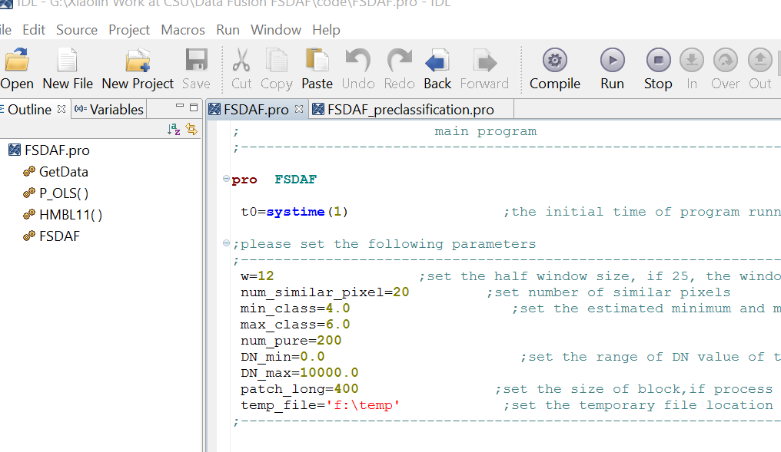
step1
Open IDL and classic ENVI;
Open the code in IDL:

Slide 4
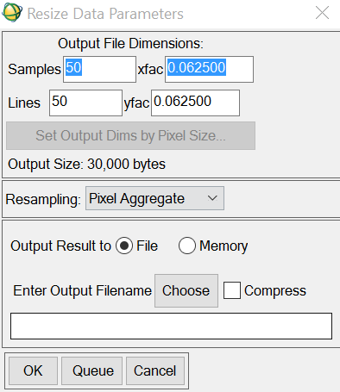
Step2
In ENVI or MODS tool: resample all MODIS images to 480 m (250 m data to 240 m) use nearest neighbor method and reproject MODIS to Landsat’s projection;
Resample Landsat image to the same resolution of MODIS (480 m or 240m) using pixel aggregate method

Slide 5
step3
Geo-rectified one MODIS image to the resampled Landsat:
Choose resampled Landsat as reference, correct MODIS.
Envi/map-registration/ select GCPs: image to image
The rule derived from GCPs applied to all MODIS images

Slide 6
step4
Crop all MODIS images by sampled Landsat, make sure they are with exactly same size:
Envi/File/save file as envi standard/import file-select MODIS image/spatial subset/file-select Landsat/ok
Resample MODIS to 30m by nearest neighbor method
For the test data, we have done step2-step4!

Slide 7
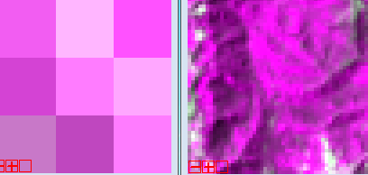
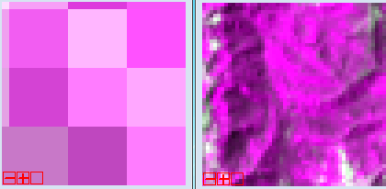
step4
Make sure all the input data with same size and all MODIS pixels are complete pixels (have 16*16 Landsat pixels inside)
BAD!
GOOD

Slide 8
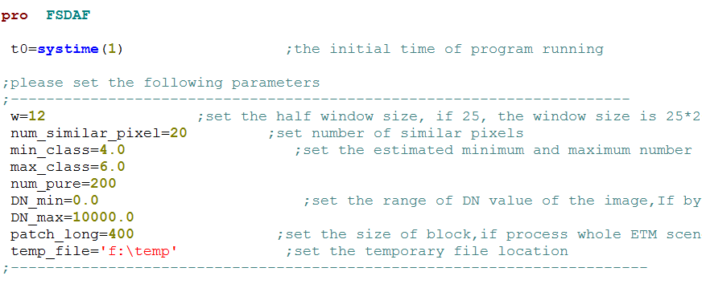
Step 5
Set the parameters
Please follow the explanation or the paper to set the parameters

Slide 9
Step 6
FSDAF: use isodata to do classification automatically. There is no need to input a classification map
FSDAF_preclassification: users need to input a classification map from the Landsat image (for the test data, “Landsat20041126_SVM_classification” is the classification map)

Slide 10
Step 7
Compile and run program:
IDL->run->compile & run…
Input data according to pop-up windows
Output: a fused image of the original MODIS file name with a suffix “_FSDAF”

